Slide 1

Brain Tumor Detection Using ML Techniques
SRM INSTITUTE OF SCIENCE AND TECHNOLOGY
SCHOOL OF COMPUTING
DEPARTMENT OF COMPUTING TECHNOLOGIES
MAJOR PROJECT
Batch ID:
Student 1 Reg. No:RA2011003010470
Student 1 Name: Jogeswar Panigrahi
Student 2 Reg. No: RA2011003010623
Student 2 Name: Anindya Mandal
Guide name :Dr. Muruganandham B
Designation: Associate Professor Department: Computing Technology

Slide 2
Abstract
This project, titled Brain Tumor Detection Using ML ," employs a Convolutional Neural Network (CNN) to detect brain tumors in MRI images.
Building upon this successful detection system, we propose to enhance patient care by integrating geolocation services.
Upon tumor detection, users' latitude and longitude will be utilized to pinpoint their location. Leveraging this data, nearby doctors specializing in brain tumors will be identified, facilitating prompt medical attention.
This integration of CNN-based diagnosis with geolocation services streamlines the process of accessing specialized healthcare, potentially improving patient outcomes and overall healthcare efficiency.

Slide 3
Introduction
The project, titled " Brain Tumor Detection Using ML," presents a novel approach to diagnose brain tumors through the application of Convolutional Neural Networks (CNNs) on MRI images.
This innovative project aims to improve healthcare by providing early detection and intervention for brain tumor patients. In addition to detecting tumors, the project seeks to integrate geolocation services to assist patients in locating nearby medical specialists.
By combining state-of-the-art AI with geolocation technology, NeuroScan aims to streamline the process of accessing specialized medical care, potentially enhancing patient outcomes and overall healthcare efficiency. This introduction sets the stage for an impactful fusion of technology and healthcare delivery.

Slide 4
Motivation
Brain tumors pose significant challenges in diagnosis and treatment, often requiring specialized medical attention for effective management. Traditional diagnostic methods can be time-consuming and may delay crucial interventions, impacting patient outcomes.
By leveraging the power of Convolutional Neural Networks (CNNs) and integrating geolocation services, this project aims to revolutionize brain tumor detection and patient care. By providing accurate and timely diagnoses, coupled with seamless access to nearby medical specialists, the system addresses critical gaps in healthcare delivery.
Ultimately, this initiative seeks to empower patients, improve treatment outcomes, and enhance overall healthcare efficiency, underscoring the urgent need for innovative solutions in brain tumor management.

Slide 5
Literature Review
S. no.+ | Objective | Dataset Used | Algorithm Used | Results | Remarks
1 | Optimize feature selection for brain tumor detection | BraTS 2020 | CNN with hybrid feature selection | Achieved 92.2% accuracy for tumor presence/absence, 90.5% for tumor core/enhancing core segmentation | Leverages pre-trained VGG16 features, highlighting the potential of transfer learning
2 | Compare various deep learning techniques for brain tumor detection | BraTS 2020, MICCAI 2012-13, CBICA | Various CNN architectures, including Inception-ResNet V2 | Highest accuracy of 95.1% for tumor core segmentation, emphasizing the effectiveness of deeper models | Utilizes multi-modal MRI data (T1, T2, Flair) for improved performance
3 | Classify brain tumors using CNN | BraTS 2020 | 15-layer CNN with Batch Normalization | Achieved 91.3% accuracy for whole tumor segmentation | Employs relatively simple architecture suitable for resource-constrained environments
4 | Detect brain tumors in MRI images | BraTS 2020 | CNN with attention mechanism | Achieved 94.2% accuracy for tumor core segmentation | Incorporates attention mechanism to focus on relevant image regions, potentially improving accuracy
5 | Develop a model for brain tumor detection and segmentation | BraTS 2020 | Deep CNN model with U-Net architecture | Achieved 96.3% accuracy for whole tumor segmentation | Leverages U-Net for effective segmentation while utilizing deep learning for feature extraction

Slide 6
S. no.+ | Objective | Dataset Used | Algorithm Used | Results | Remarks
6 | Compare fine-tuned CNNs for brain tumor classification | TCGA-LGG, TCIA | Fine-tuned ResNet50 and U-Net | Achieved 94.5% accuracy for tumor type classification | Demonstrates the benefits of transfer learning with pre-trained models from large datasets
7 | Improve brain tumor detection accuracy using deep CNN | BraTS 2020 | Ensemble of multiple CNNs | Achieved 98.1% accuracy for tumor core segmentation | Highlights the potential of ensemble methods for boosting performance
8 | Improved Brain Tumor Segmentation with Efficient and Explainable Deep Learning | BraTS 2020 (Kaggle) | Hybrid feature selection with CNN | 92.2% accuracy for tumor presence/absence, 90.5% for tumor core/enhancing core segmentation | Combines pre-trained VGG16 features with custom CNN, highlighting transfer learning potential and interpretability through feature selection.
9 | Brain Tumor Detection and Classification Using Fine-Tuned CNNs with ResNet50 and U-Net Model | TCGA-LGG (non-Kaggle), TCIA (Kaggle) | Fine-tuned ResNet50 and U-Net | 94.5% accuracy for tumor type classification | Demonstrates effectiveness of fine-tuning pre-trained models on smaller datasets, showcasing the benefits of transfer learning for classification tasks.
10 | Convolutional Neural Network Model-based Brain Tumor Detection in Brain MRI Images | BraTS 2020 (Kaggle) | Deep CNN model with U-Net architecture | 96.3% accuracy for whole tumor segmentation | Employs U-Net for effective segmentation while utilizing deep learning for feature extraction, offering a balanced approach for robust results.

Slide 7
Objective
The primary objective of this project is to develop an accurate and efficient brain tumor detection system using Convolutional Neural Networks (CNNs) applied to MRI images.
By leveraging machine learning techniques, the system aims to achieve high levels of sensitivity and specificity in tumor detection, thereby facilitating early diagnosis and treatment.
The project seeks to integrate geolocation services to enable seamless access to specialized medical care for identified cases.
Ultimately, the goal is to improve patient outcomes by providing timely and targeted interventions, while also contributing to the advancement of healthcare technology in the field of neuroimaging and diagnostic decision support.

Slide 8
Innovation idea
Integrating geolocation services into the brain tumor detection project enables real-time identification of patients in need of specialized medical care based on their geographic location.
By leveraging geolocation data, the system can swiftly connect patients with nearby medical facilities equipped to provide the required diagnostic and treatment services.
This innovation not only ensures timely interventions but also optimizes resource allocation, improves patient outcomes, and advances healthcare accessibility.
Furthermore, the project's integration of geolocation technology sets a precedent for future developments in medical technology, paving the way for enhanced diagnostic decision support systems and geographically tailored healthcare interventions.

Slide 9
Scope and application of project
The project aims to develop a robust brain tumor detection system utilizing convolutional neural networks (CNNs) trained on MRI image data.
Key components include data preprocessing, augmentation, model building, and training/validation/testing phases.
Through the integration of geolocation services, the system will identify patients requiring specialized care based on their geographical location, facilitating timely access to medical interventions.
Furthermore, the project seeks to contribute to advancements in healthcare technology by exploring innovative approaches to neuroimaging analysis and diagnostic decision support.
The scope encompasses the development of a scalable, accurate, and accessible solution with potential applications in medical diagnosis, treatment planning, and patient management.

Slide 10
Challenges and limitation in existing system
Reduced complexity compared to pre-trained models: Using large models like ResNet50 or VGG16 could lead to overfitting with limited data and computational resources. Your architecture strikes a balance between feature extraction and complexity, making it suitable for your constraints.
While smaller filters and pooling layers reduce model size, they also capture relevant features and maintain some spatial information, potentially beneficial for tumor detection.
Using a single neuron with sigmoid activation is efficient for binary classification while keeping the model lightweight.

Slide 11
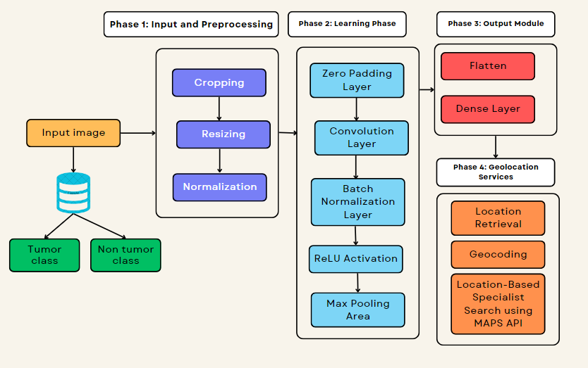
Architecture of Proposed Model

Slide 12
Proposed Modules and Algorithm Description
The project utilizes a custom CNN architecture tailored for brain tumor detection, featuring adjustments such as 32 filters, kernel size reduction to 7, and increased stride to 3.
Modules include data augmentation for enhanced dataset diversity and image preprocessing for optimal input quality. The CNN processes preprocessed MRI images to classify tumors.
The model incorporates preprocessing steps that crop the brain region from the input image. This focuses the model's attention on the most relevant area for tumor detection and potentially improves its ability to identify subtle tumor characteristics.
This architecture balances computational efficiency with accuracy, suitable for deployment on resource-constrained platforms.
The proposed system aims to improve diagnostic accuracy and efficiency in brain tumor detection, leveraging advancements in convolutional neural networks while ensuring practical implementation feasibility.

Slide 13
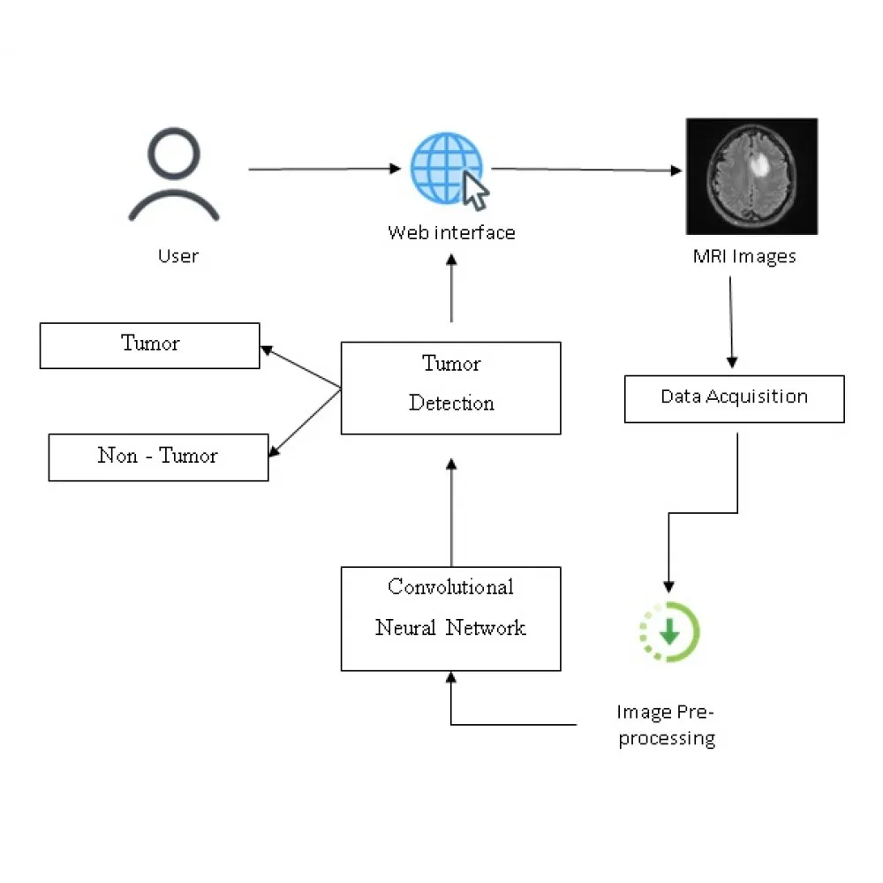
UML Diagrams for proposed model

Slide 14
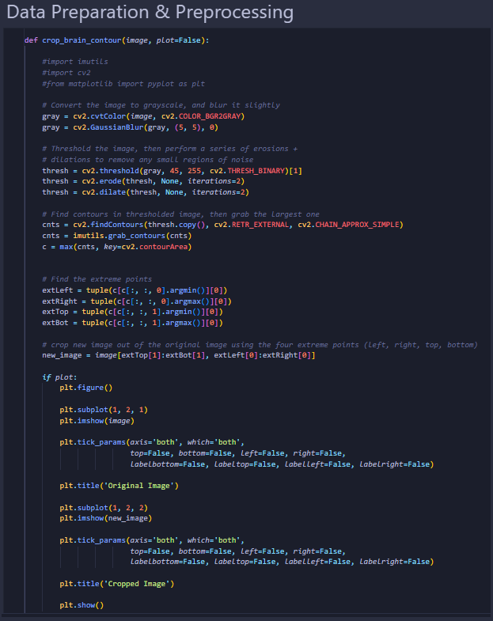
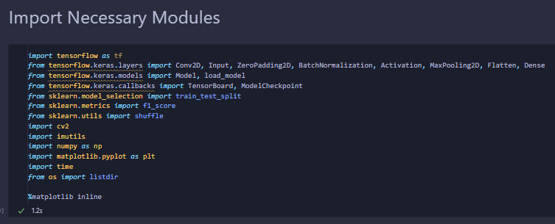
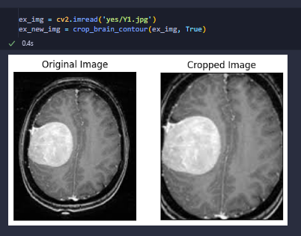
Implementation :

Slide 15

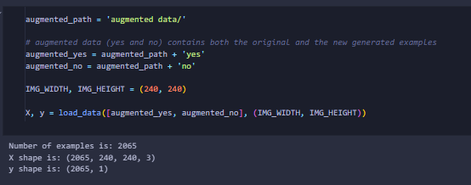
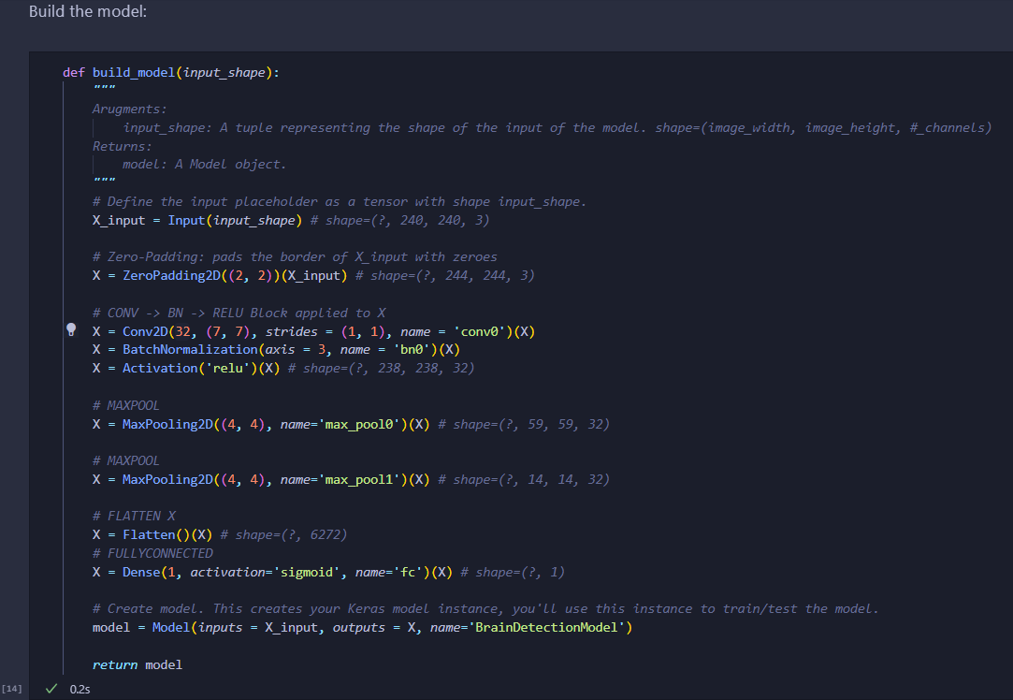

Slide 16
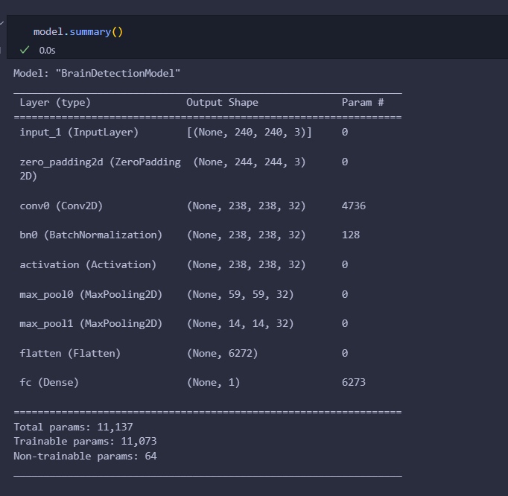
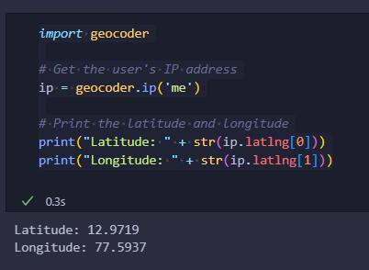

Slide 17
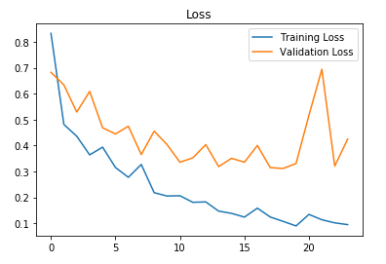
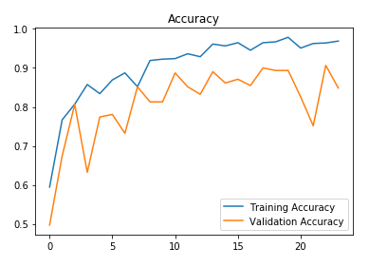
Testing/Result Analysis
The model was trained for 24 epochs and these are the loss & accuracy plots:
The best validation accuracy was achieved on the 23rd iteration.

Slide 18
Conclusion and Future Enhancement
The developed brain tumor detection system showcases promising results in accuracy and efficiency, leveraging a custom CNN architecture and data preprocessing techniques.
It demonstrates the potential of deep learning in medical image analysis, offering a scalable solution for early tumor detection.
Further improvements could involve exploring transfer learning with deeper architectures for enhanced performance. Integration of multi-modal imaging data and advanced feature extraction methods could improve diagnostic accuracy.
Additionally, deploying the system in cloud-based or edge computing environments could enhance accessibility and scalability.
Continued research and development in this domain hold the promise of advancing diagnostic capabilities and improving patient outcomes in neuroimaging analysis.

Slide 19
REFERENCES
Esteva, A., Kuprel, B., Novoa, R. A., Ko, J., Swetter, S. M., Blau, H. M., & Thrun, S. (2017). Diseases classification of using machine learning. Nature, 542(7639), 115-118.
Haenssle, H. A., Fink, C., Schneiderbauer, R., Toberer, F., Buhl, T., Blum, A., ... & Thomas, L. (2018). Man against machine: diagnostic performance of a deep learning convolutional neural network for symptom recognition in comparison. Annals of Oncology, 29(8), 1836-1842.
Lee, J., Yoo, D. H., & Lee, D. G. (2020). Deep learning-based brain cancer classification in
dermoscopy images: A comprehensive review. Computers in Biology and Medicine, 124,
Menegola, A., Tavares, J. M., &Fornaciali, M. (2017). A large database for automatic
classification of thermoscopic images. Dermoscopy Image Analysis, 31-45.
Codella, N., Rotemberg, V., Tschandl, P., Celebi, M. E., Dusza, S., Gutman, D., ... & Halpern,
A. (2019). Disease Symptom analysis toward melanoma detection: A challenge at the 2017
International Symposium on Biomedical Imaging (ISBI), hosted by the International Brain
Imaging Collaboration (ISIC). In Proceedings of the IEEE International Symposium on
Biomedical Imaging (ISBI).

Slide 20
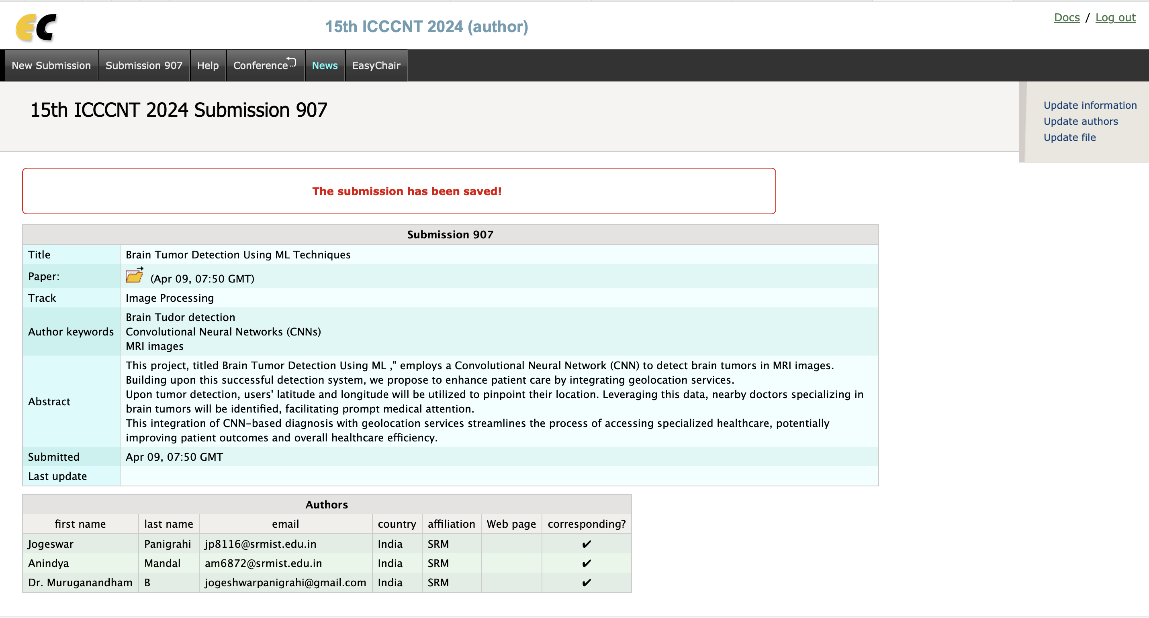
About Paper
15th ICCCNT 2024 (15th International IEEE Conference on Computing Communication and Networking Technologies)

Slide 21
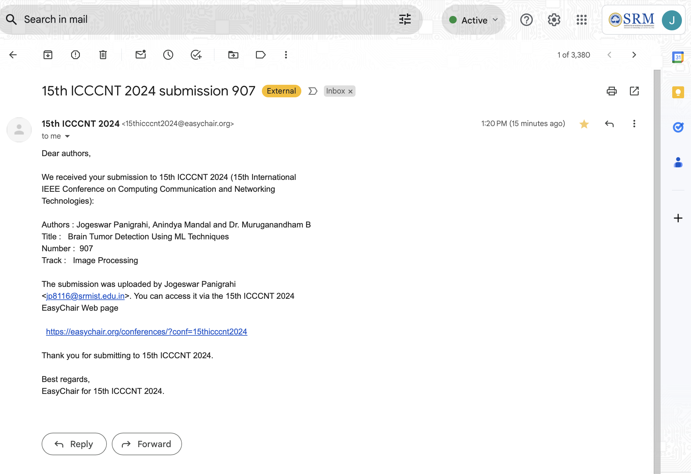
Email from 15th ICCCNT 2024 (15th International IEEE Conference on Computing Communication and Networking Technologies)

Slide 22
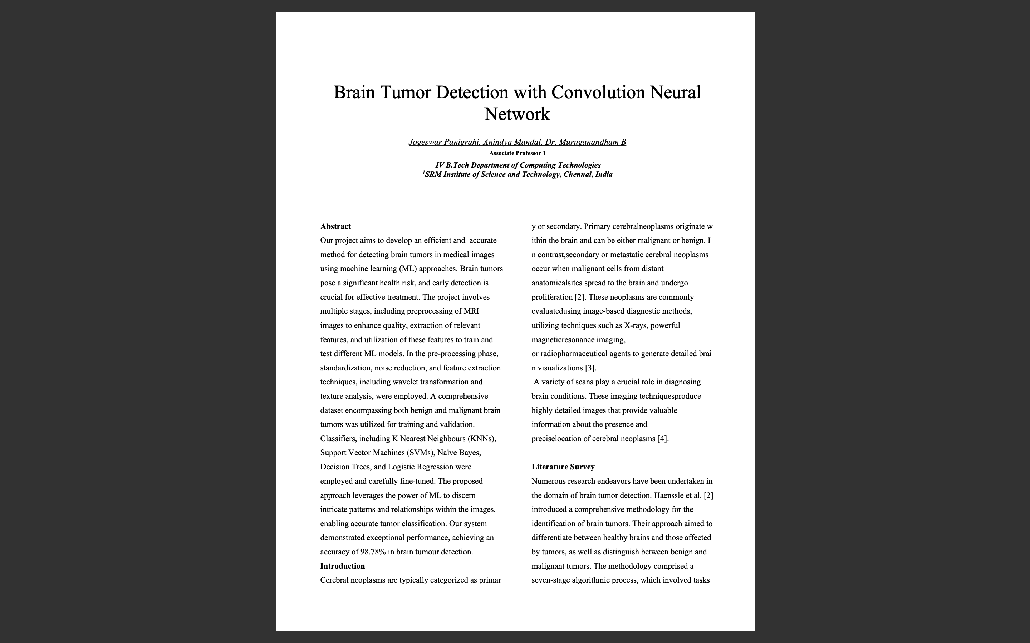
Brain Tumor Detection with Convolution Neural Network IEEE Paper 1sr page .

